Slide 1
INFX 575 - Data Science III Project
Stack Overflow Data
Presented By:
Ayoush Mukherjee ~ Shipra Gupta ~ Shreya Agarwal

Slide 2
Agenda
Why Stack Overflow?
Prior Research
Research Questions
Preliminary Findings
Techniques
Potential Challenges

Slide 3

Why Stack Overflow??
Stack Overflow is the largest online community for programmers to learn, share their knowledge, and advance their careers.
It aims to bring solutions to day to day problems faced by them.
Stack Overflow offers a great interface for accessing all of its data and running any possible query in the questions/answers database.

Slide 4
Prior Research: What drives the SO Community
Stack Exchange has a clear purpose
The use of a voting system
The use of reputation and badges
The great content available
The awesome moderation system
The possibility to edit someone else's content
A dedicated site just for problems, suggestions and bug reports
Really good search options like combine tags, exclude tags, specific user, specific range of votes, specific range of number of answers, is closed, etc.

Slide 5
Research Questions
Predicting how soon/late will a question posted on Stack Overflow get a response from the community
Based on the subject-matter of the question.
Based on other features of the question.
Predicting which user is likely to answer a question posted on Stack Overflow from the top 15 users
Notes:
One advantage of large scale collaborative sites like Wikipedia and StackOverflow is the speed at which new information accumulates. Some questions on StackOverflow seemed to get answered immediately while others sit around for a while. As you are writing your question, it would be cool to have an idea of how long it might take to get answered. How well can you predict the time until a question gets answered? This will likely depend on the subject matter of the question, since some programming communities are more active than others.

Slide 6
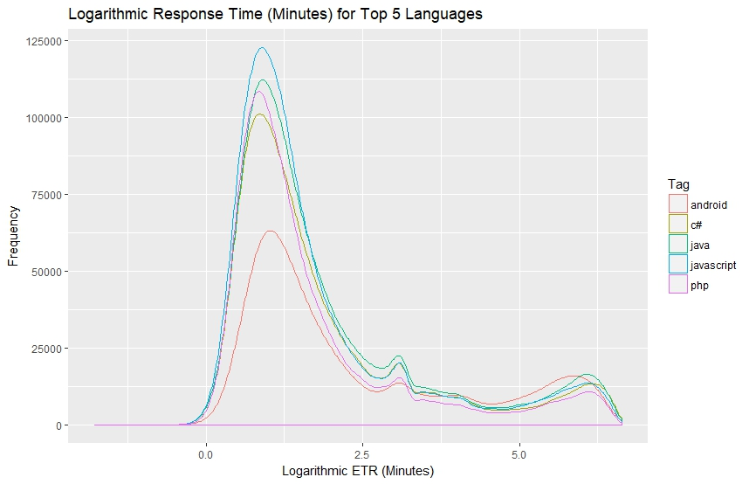
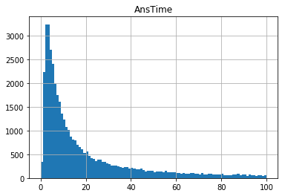
Preliminary Analysis

Slide 7
Top Users Preliminary Analysis
For approaching the question of predicting who will be answering a question, we wanted to check for these top 5 languages, who are the top 5 users for each language and their response count. Below table shows top 5 users and their response count:
Language | UserID-Count | UserID-Count | UserID-Count | UserID-Count | UserID-Count
Javascript | 19068 - 831 | 157247- 819 | 114251- 652 | 1048572-635 | 816620- 612
Java | 22656-1774 | 23354-1026 | 17034-840 | 29407-702 | 34397-587
C# | 115145-1811 | 1202025-324 | 501696-301 | 653856-273 | 1631193-228
PHP | 118068-752 | 285587-511 | 476-511 | 1491895-430 | 367456-404
JQuery | 114251-908 | 965051-535 | 519413-488 | 157247-429 | 13249-423

Slide 8
Techniques
Text Preprocessing
Noise Removal, Lexicon Normalization (Lemmatization, Stemming), Removing stop-words, TFIDF, bag of words(trigram), word2vec
Machine Learning Models
Naïve Bayes Classifier, Stochastic Gradient Descent, Support Vector Machine, Random Forest
Evaluation Methods
Confusion Matrix, Recall and Precision, Accuracy

Slide 9
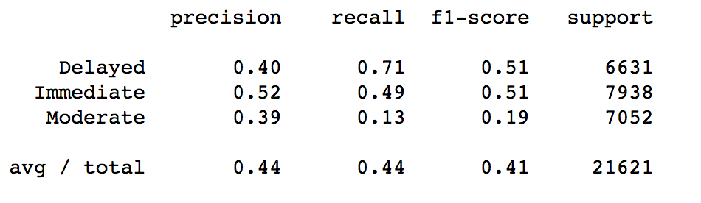
Predicting Response Time for a Question
Text Classification – Question Body
Model Used: Multinomial Naïve Bayes Classifier
44% Accuracy

Slide 10
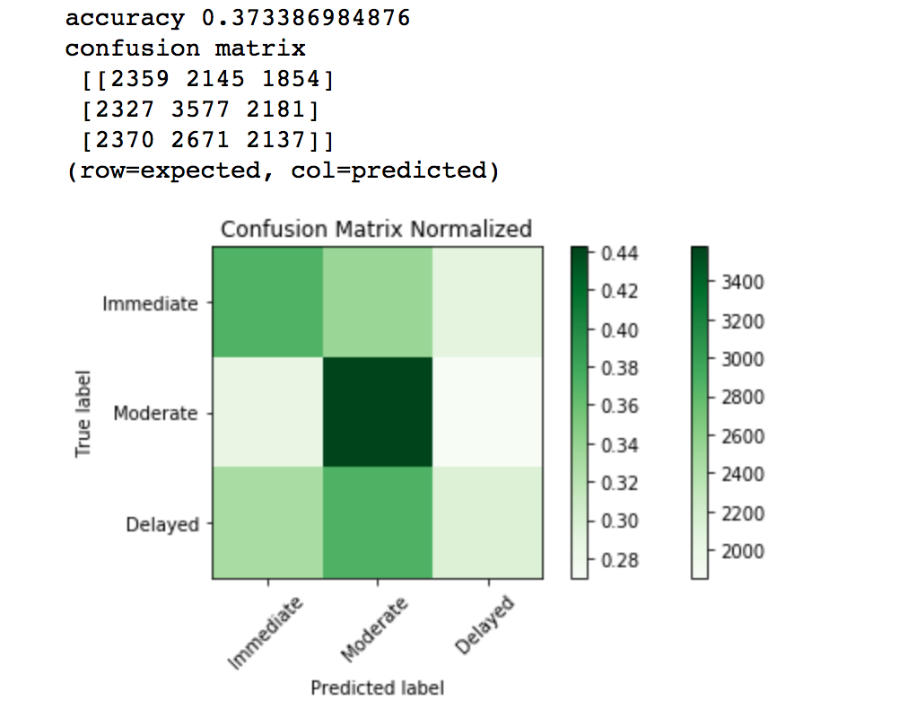
Predicting Response Time for a Question
Model Used: Naïve Bayes and Random Forest
Features: Tag Count, Question Score, Has Code, Has Link, Question Body Length, Question Title Length

Slide 11
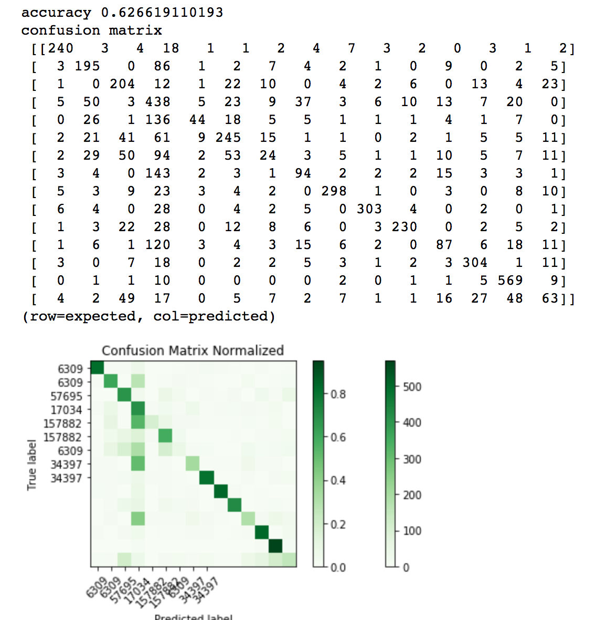
Predicting the Answerer for a Question
Model(s) Used: Linear Support Vector Machine

Slide 12
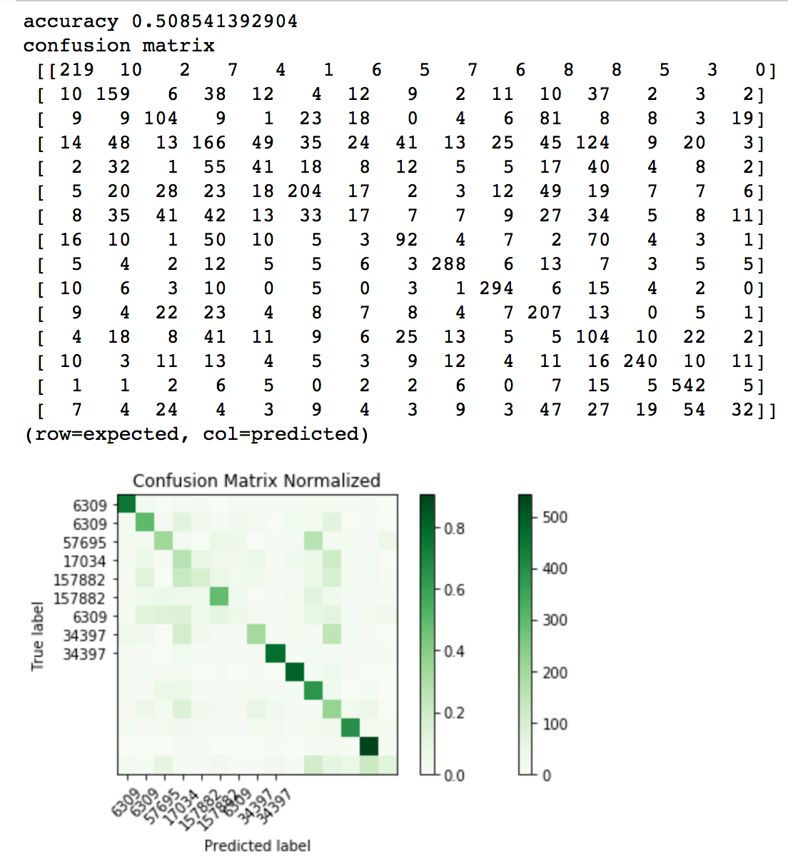
Predicting the Answerer for a Question
Stochastic Gradient Descent

Slide 13
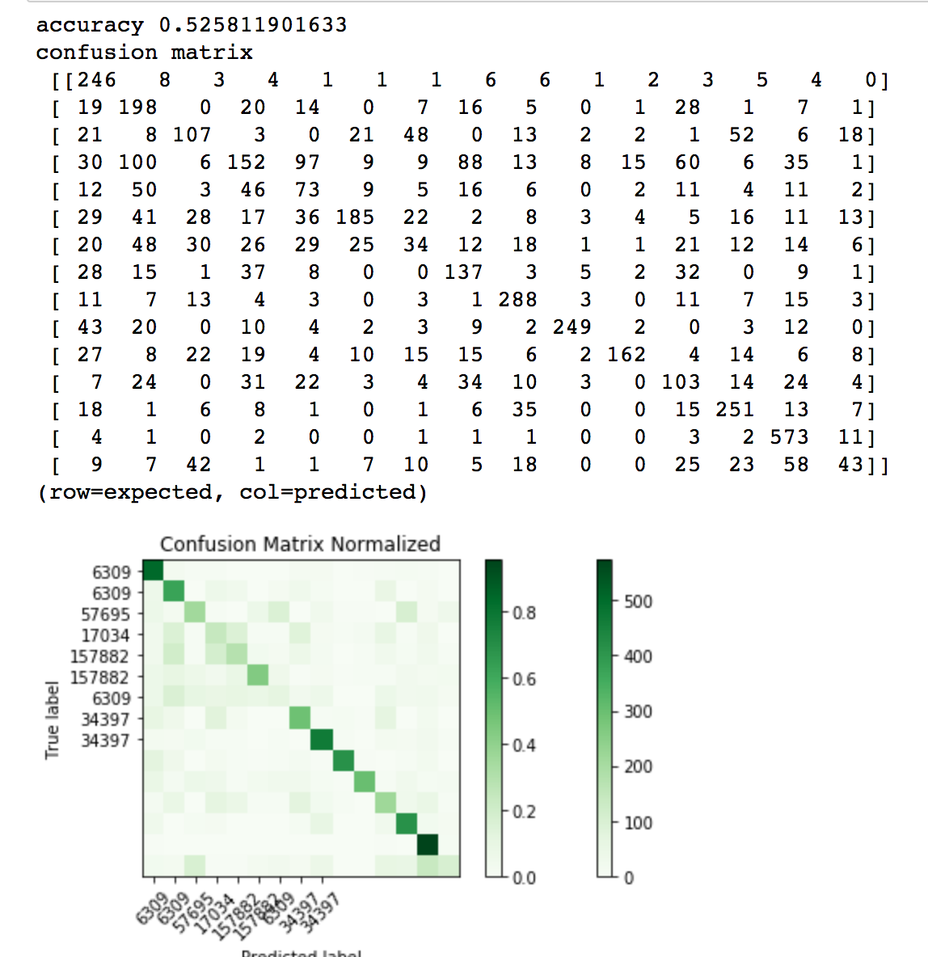
Predicting the Answerer for a Question
Multinomial Naïve Bayes

Slide 14
Visualizations

Slide 15
Challenges and Limitations
Various iteration to get 10%sample data from 50gb dataset
No strong correlation between the features for performing regression analysis
Improving the accuracy of the classification model
Skewed and messy data

Slide 16
Thank You

